Slide 1
China Certification & Inspection Group Macau Co., LTD

Slide 2
CONTENTS
CCIC MACAU
ABOUT US
PRODUCT&SERVICES
LABORATORY CAPABILITY

Slide 3
ABOUT US
Company profile
Company Structure

Slide 4
Company Profile
China Certification & Inspection Group Macau Co., LTD
CCIC Macau, as a comprehensive inspection & certification organization devoted to providing inspection & appraisal, certification & testing, health management, and consulting services, is authorized by the Hong Kong and Macau Affairs Office of the State Council and directly managed by the Certification and Accreditation Administration (CNCA).
It is also the only agency accredited by former General Administration of Quality Supervision, Inspection and Quarantine of the People's Republic of China(AQSIQ) to carry out inspection and quarantine operations in Macau.
The headquarter is located at 4th Floor, Guanghui Commercial Center, Song Yusheng Plaza, New Port of Macau. Currently, CCIC Macau has subsidiaries:
CCIC (Macau) Inspection & Analysis Co., LTD.
Kuok Kim (Macau) Hygiene Testing Co., LTD
CCIC (Macau) Information Technology Consulting Co. LTD
CCIC Health (Zhuhai) Industry Co., LTD

Slide 5
Company Structure
CCIC (Macau) Inspection & Analysis Co., LTD.
- An independent third-party testing institution accredited by China national accreditation service for conformity assessment (CNAS)
Kuok Kim (Macau) Hygiene Testing Co., LTD
- Established at Macau with the authorization of CNCA and CCIC
- A health care service and health inspection institution directly under the management of CCIC Macau
1
2
CCIC Health (Zhuhai) Industry Co., LTD
- Affiliated to CCIC Macau
- A health industry based service organization highly connected with Macau company
CCIC (Macau) Information Technology Consulting Co. LTD
- Strong talent and technical advantages in the field of IT
- Adhering to the rigorous and pragmatic style of CCIC
3
4

Slide 6
PRODUCT&SERVICES
Environment
Health
Safety

Slide 7
Health
Physical examination
Vaccination | Drug Consultation | Health Medical Examination Consultation | International Medical | Protein Chip Detection Technology | Child-friendly Certification | Ultrasonic Examination Service| Physical Examination Service for foreign workers/dual license drivers | Referral Service | Protein Chip Detection | Health Consultation | Health Management| Health Food | International Medical Service|
Medical Treatment
Vaccination

Slide 8
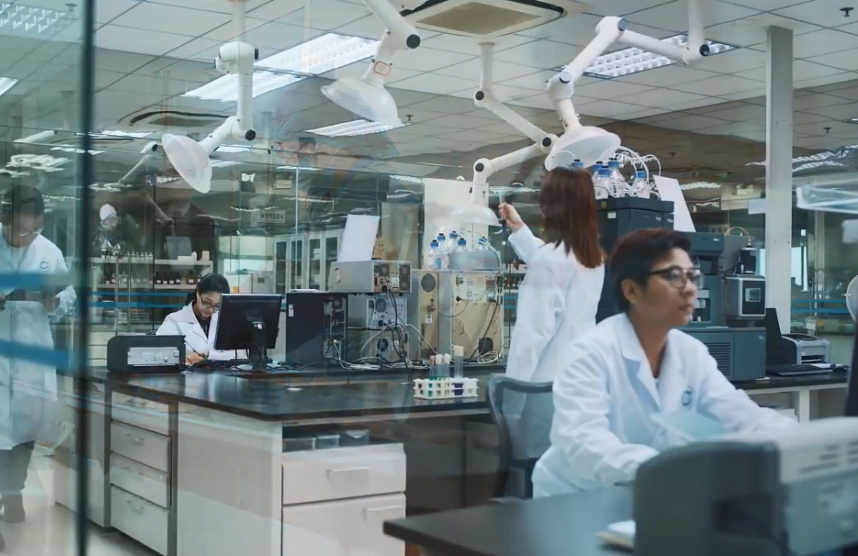
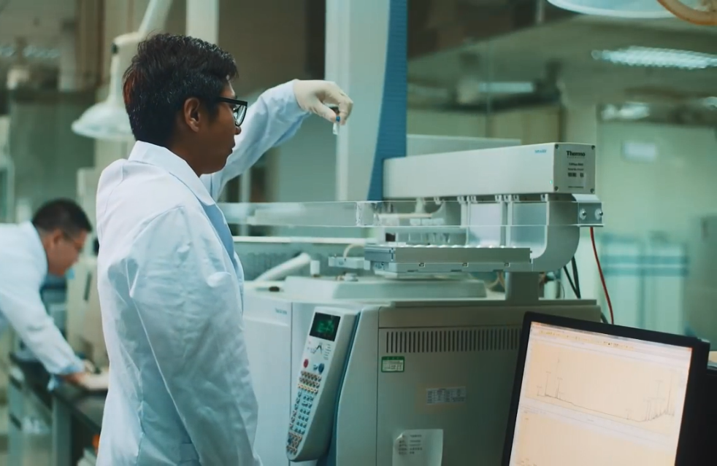
Environment
Laboratory Testing
Water Quality Detection
Aerial Detection
Soil Detection
Instrument Calibration

Slide 9
Safety
Food
Inspection
Computer
network
Pre-shipment Inspection of Renewable Resources (PSI) | Food Inspection | Used Mechanical and Electrical Products Inspection | Trademark Authorization Business | Return Inspection | Food Enterprise Integrity Certification | Information Safety Management System Certification (ISO27001) | Information Technology Service Management System Certification (ISO20000) | Information Construction Consulting | Safety Evaluation | Safety Training |

Slide 10
LABORATORY CAPABILITY
Kuok Kim Hygiene Testing
Testing& Analysis Center

Slide 11
Kuok Kim Hygiene Testing
Reception

Slide 12
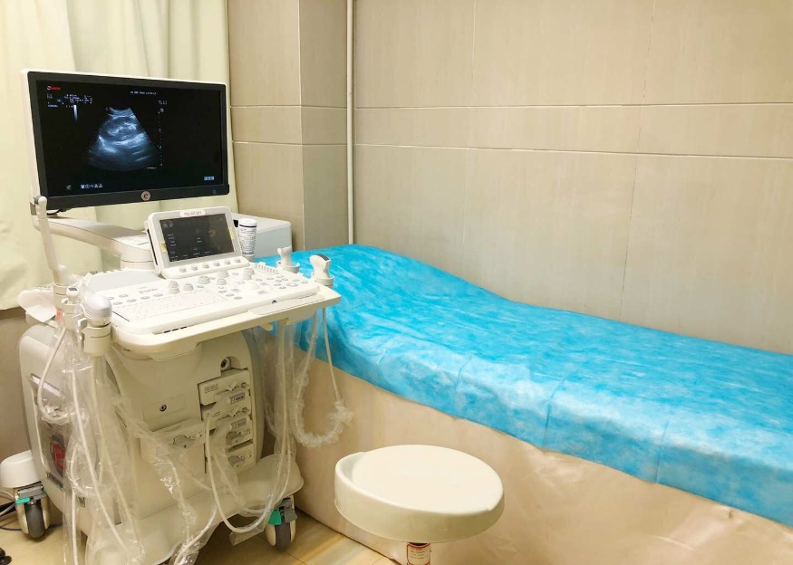
Kuok Kim Hygiene Testing
4D Ultrasound Examination

Slide 13
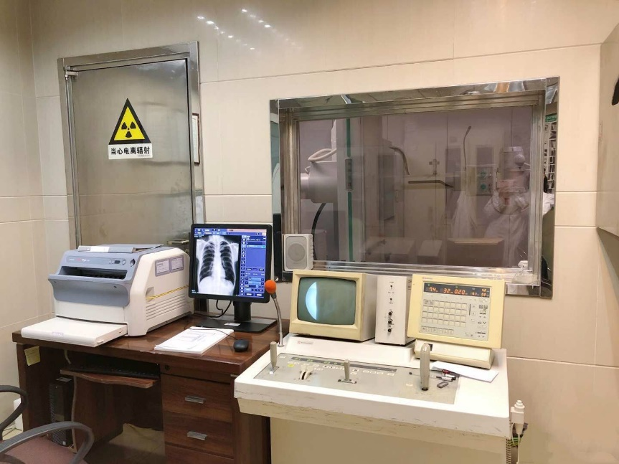
Kuok Kim Hygiene Testing
X-Ray Laboratory

Slide 14
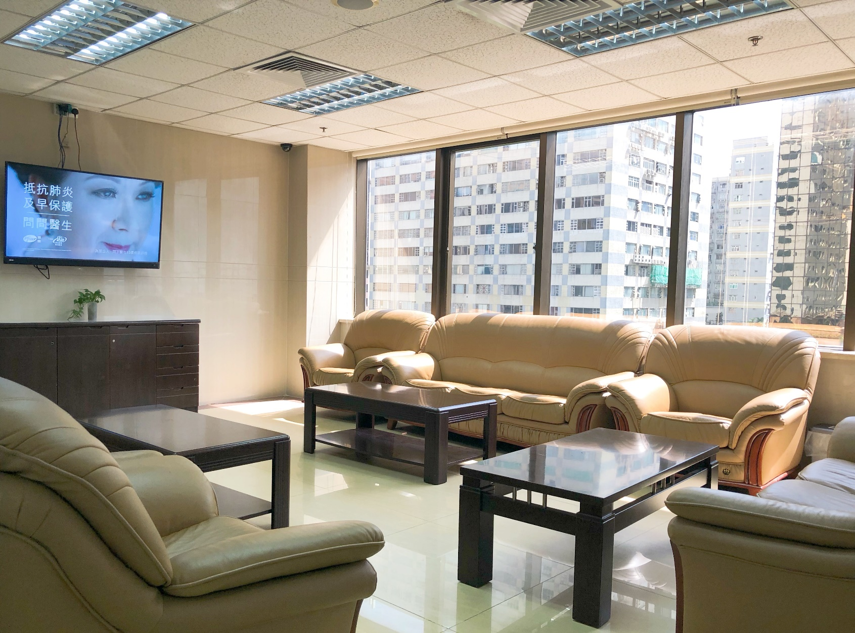
Kuok Kim Hygiene Testing
Waiting Area

Slide 15
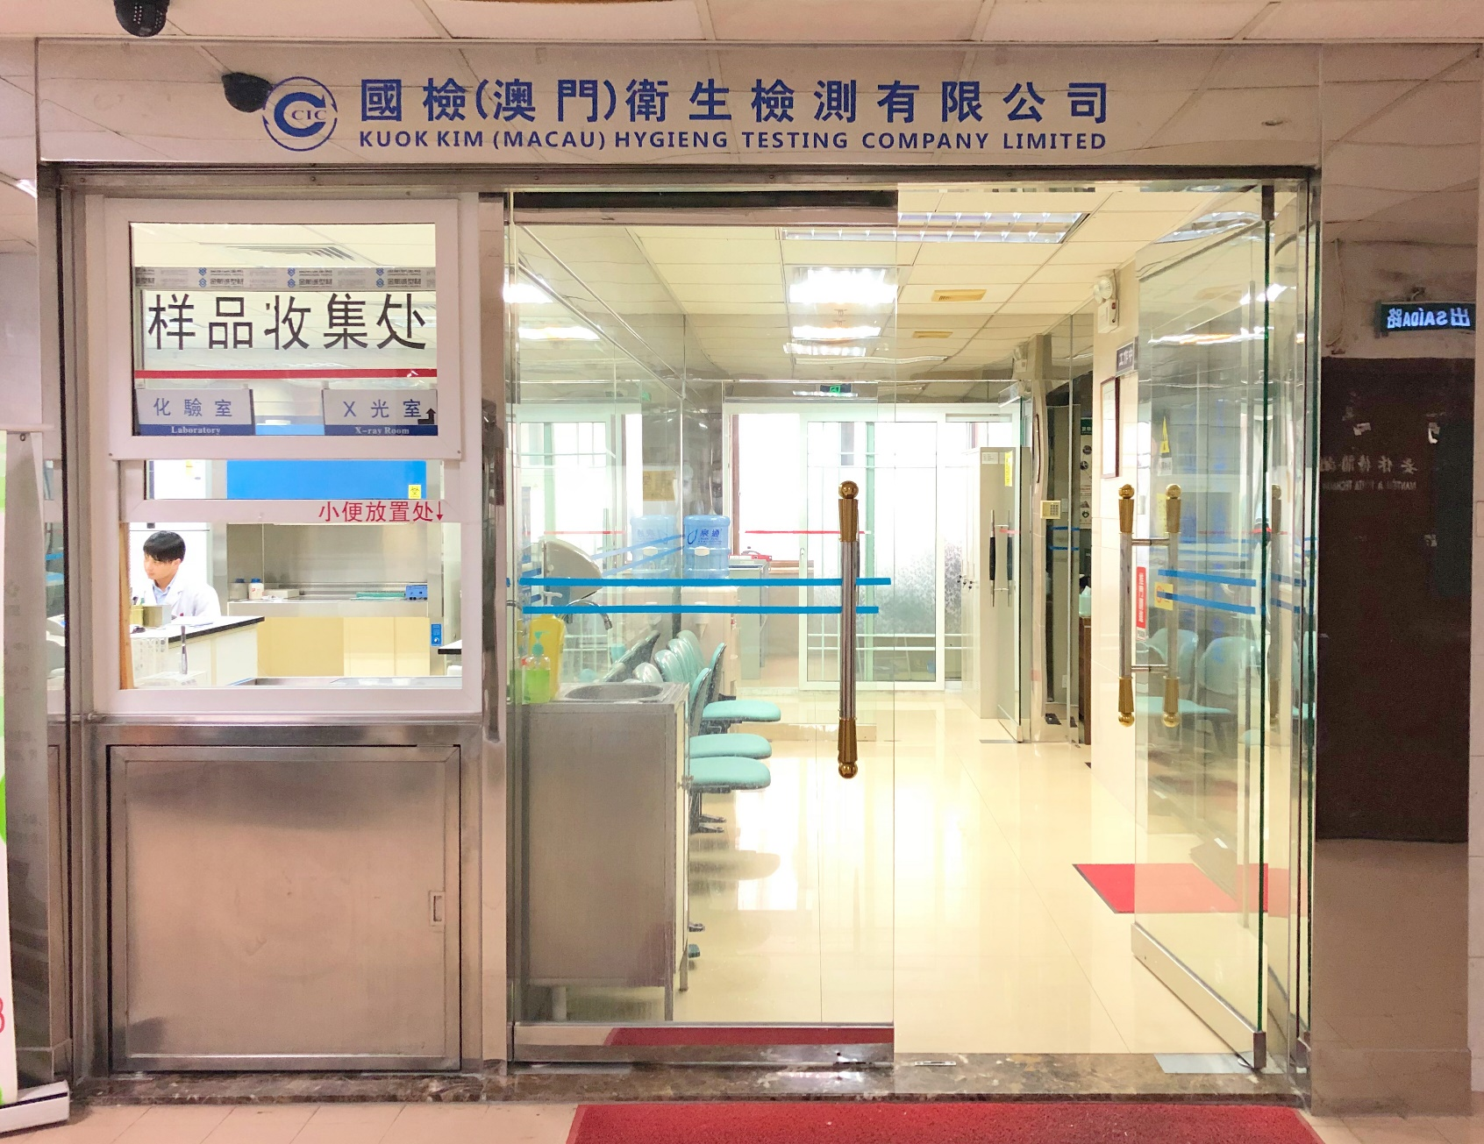
Kuok Kim Hygiene Testing
Laboratory

Slide 16
Kuok Kim Capacity
Visceral Scan
Gynecological Scan
Cardiovascular Doppler Scan
X Ray
Liver
Gall bladder
The spleen
The pancreas
Kidney
The prostate gland
Bladder
Digestive system scan (liver, bile, spleen, pancreas)
Urinary system scan (double kidney, bladder, prostate)
Upper abdominal scan (liver, bile, spleen, pancreas, kidney)
Total abdominal examination (liver, bile, spleen, pancreas, kidney, bladder, prostate or uterine appendices)
Pelvic scan (bladder, prostate or uterine appendages)
Gynecological scan (uterus, appendix)
Follicular development monitoring
Chest film (positive position)
Rib (positive, oblique)
Clavicle (AP)
Cervical, thoracic, lumbosacral
Shoulder joint (AP)
Sternoclavicular joint (AP)
Humerus (normal, lateral)
Forearm (front, side)
Elbow joint (normal, lateral)
Wrist joint (positive, lateral)
Hand and phalanx (normal, lateral)
Pelvis (AP)
Femur (anteroposterior, lateral)
Knee joint (positive, lateral)
Tibia, fibula (normal, lateral)
Ankle joint (positive, lateral)
Feet, toes (positive, oblique)
Regular Inspection
Measure the NT value
4D ultrasound scan of the fetus
Carotid artery
Vertebral artery
Renal artery
Abdominal aorta
Single artery
Single vein
The heart
Superficial organ scanning
Glandular gland
Mammary gland
Testis
Subcutaneous mass
Other individual parts
Electrocardiogram(ECG)
EKG Resting

Slide 17
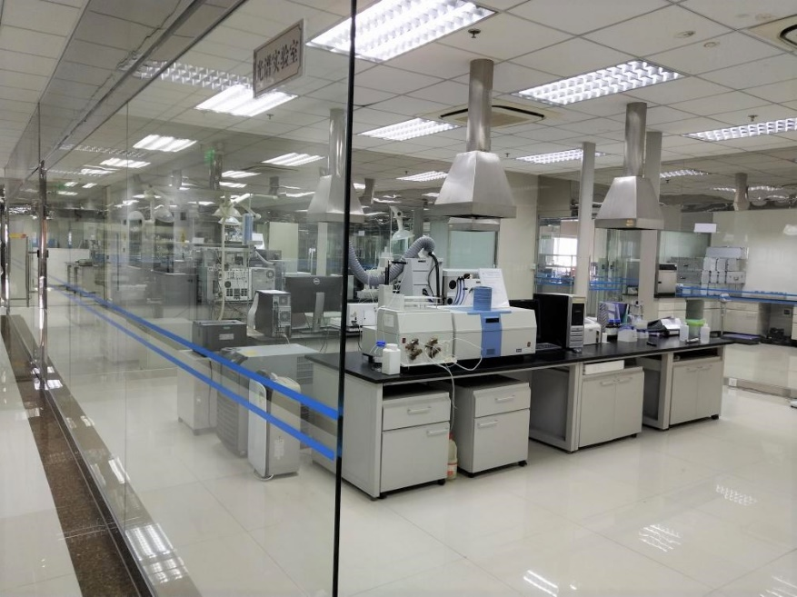
Testing & Analysis Center
Spectrographic Laboratory

Slide 18
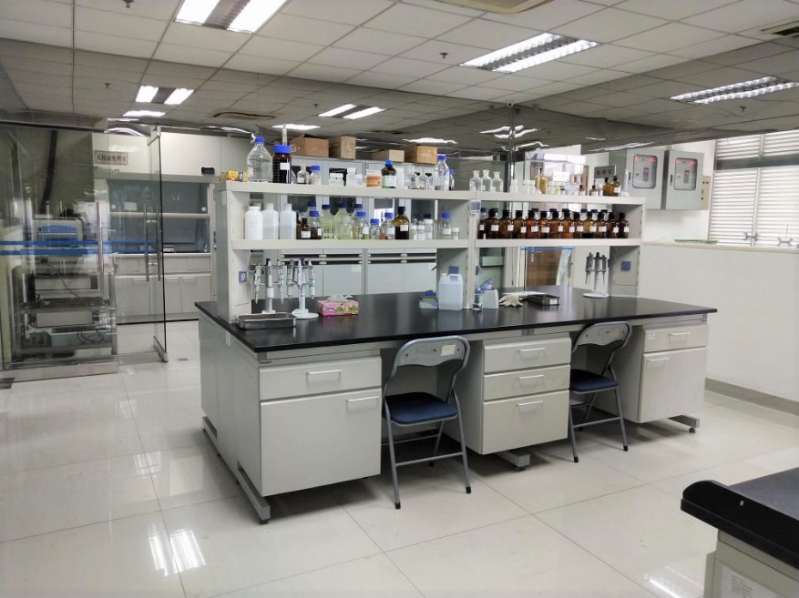
Testing & Analysis Center
Physics and Chemistry Laboratory

Slide 19
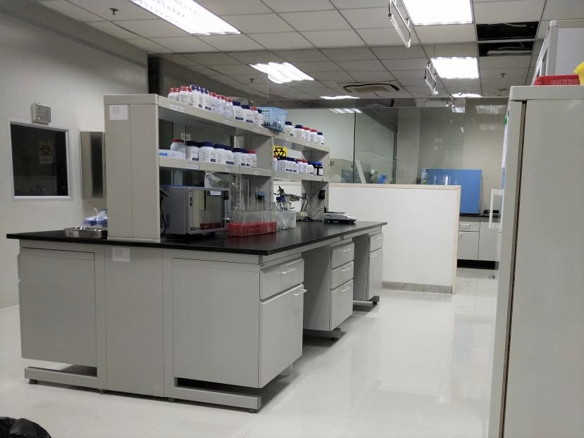
Testing & Analysis Center
Microbiology Laboratory

Slide 20
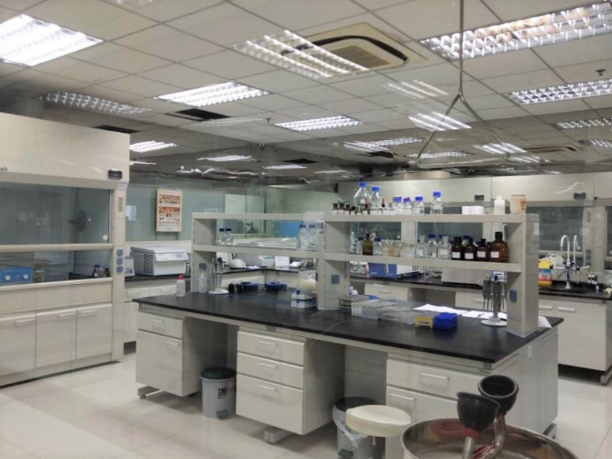
Testing & Analysis Center
Sample Pretreatment Lab

Slide 21
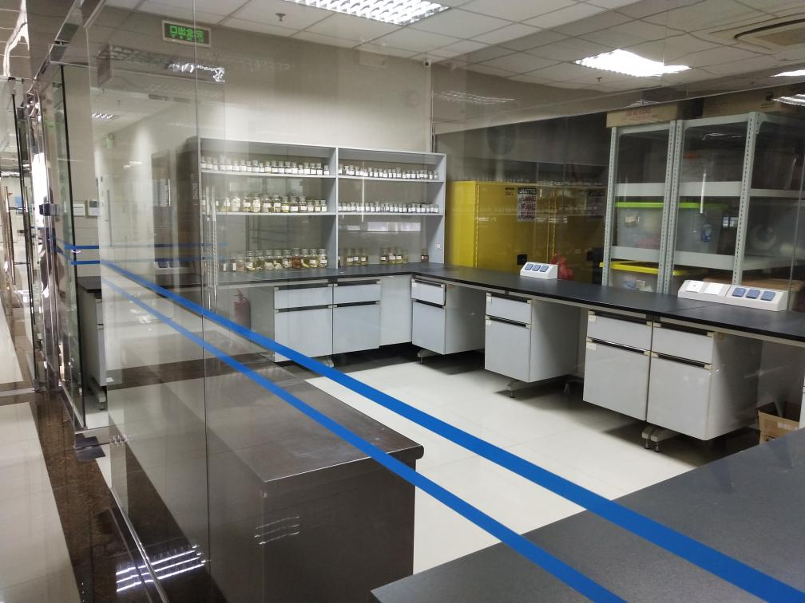
Testing & Analysis Center
Animal and Plant Inspection and Quarantine Laboratory

Slide 22
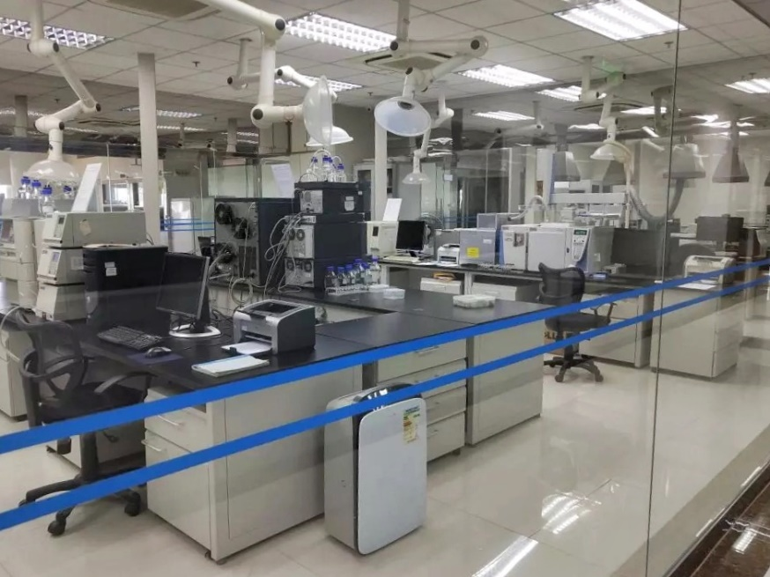
Testing & Analysis Center
Chromatography and Mass Spectrometry Lab

Slide 23
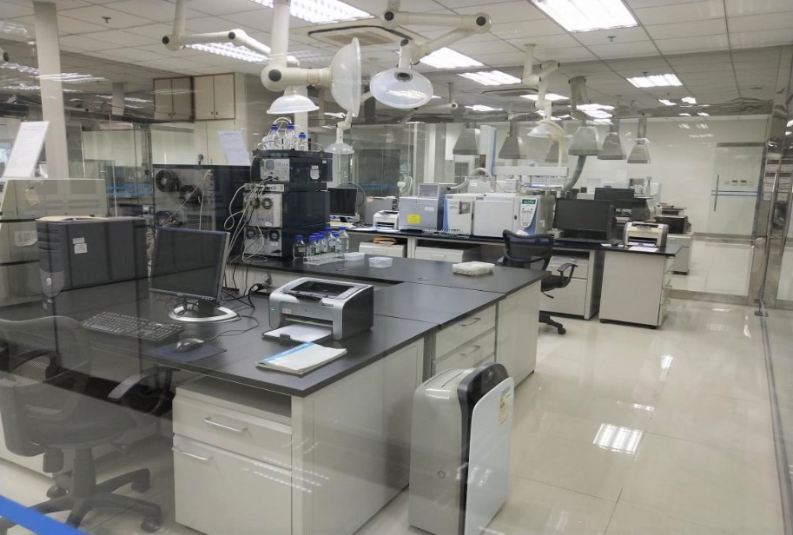
Testing & Analysis Center
Chromatography and Mass Spectrometry Lab

Slide 24
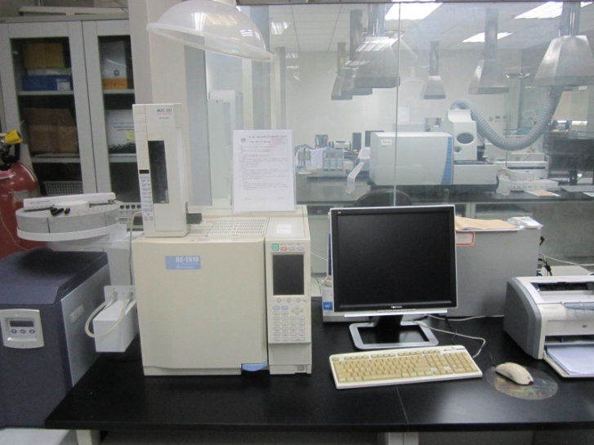
Testing & Analysis Center
Gas Chromatograph (GC)

Slide 25
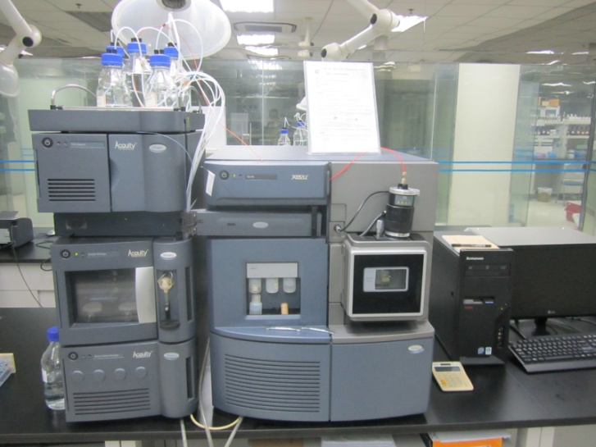
Testing & Analysis Center
UPLC/MS/MS

Slide 26
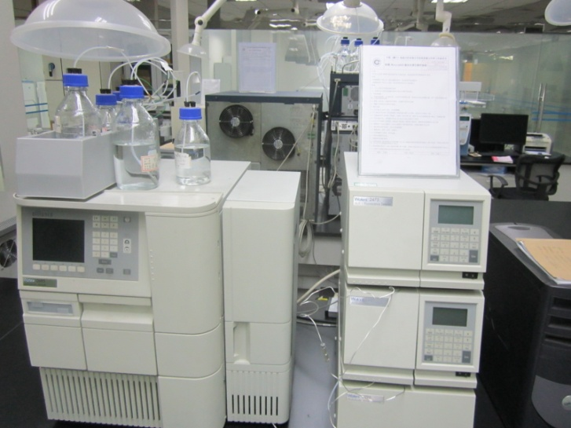
Testing & Analysis Center
Liquid Chromatography (LC)

Slide 27
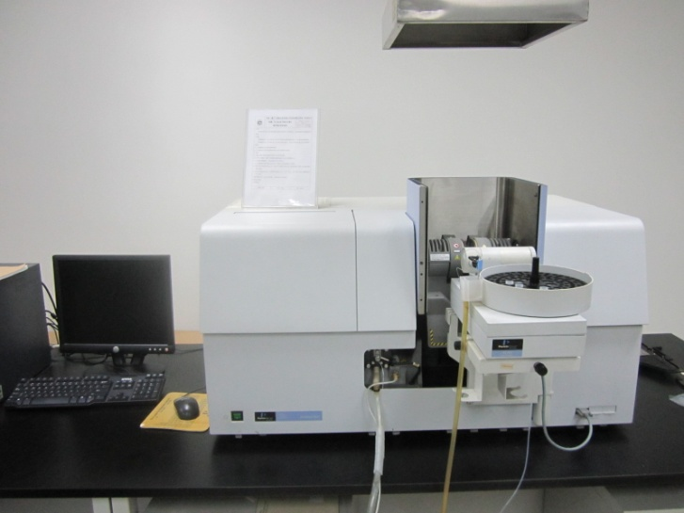
Testing & Analysis Center
Atomic Absorption Spectrophotometry (AA)

Slide 28
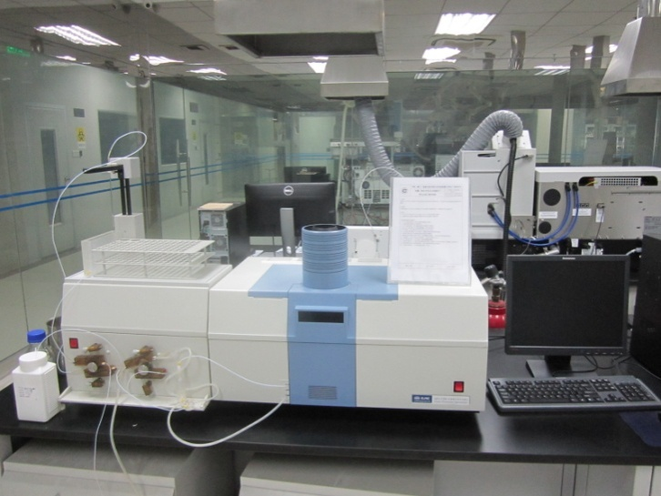
Testing & Analysis Center
Atomic Fluorescence Spectrophotometer (AFS)

Slide 29
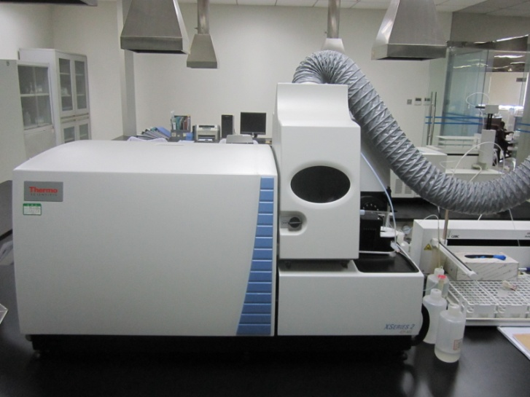
Testing & Analysis Center
Inductively Coupled Plasma Source Mass Spectrometer（ICP/MS）

Slide 30
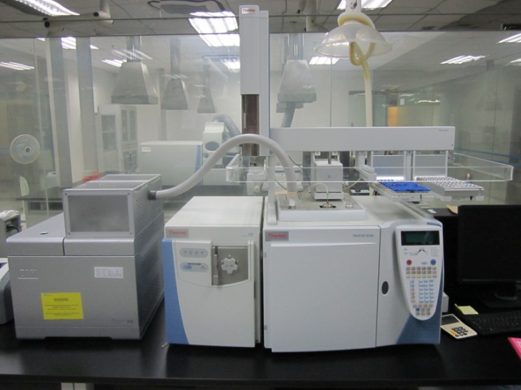
Testing & Analysis Center
Gas Chromatography/ Mass Spectrometry （GC/MS）

Slide 31
Testing & Analysis Center Capacity
Food Testing
Cosmetics Testing
Toy Testing
Water Quality Testing
Food quality inspection
Detection of pesticide residues
Analysis of heavy metals and trace elements
Food additive test
Detection of food nutrients
Food microorganism detection
Food label component detection
Detection of radioactive contamination of food
DNA identification of animal tissues
Detection of toxic and harmful substances
Analysis of heavy metals and trace elements
Microbiological examination, etc
Radioactive contamination detection
Phthalate detection
Heavy metal detection
Physical performance test
Sensory properties and physical indicators
Inorganic nonmetal index
Metal index
Comprehensive index of organic matter
Pesticide indicators
Disinfectant index
Microbial index
Radioactive contamination detection
Petrochemical Product Testing
Chemical Product Testing
Product quality inspection
Analysis of heavy metals and trace elements
Detection of toxic and harmful substances
Microbiological examination
Physical and chemical index detection
Calorific value detection
Element detection
Organic content detection
Octane number detection
Environmental Sample Test and Environmental Assessment Report
Testing of of materials and products in contact with food
Textile Testing
Waste water detection
Exhaust gas detection
Detection of toxic and harmful substances in solid waste
Radioactive contamination detection
Noise detection
Environmental Assessment Report
Glass, aluminum utensils containers
Raw paper for food packaging
Bamboo products
od products
Melamine-formaldehyde molding
Product quality inspection
Analysis of heavy metals and trace elements
Forbidden azo dye detection
Formaldehyde content detection
Detection of toxic and harmful substances
Fiber content detection

